Slide 1
Adapting NBA Clustering Model for Prediction
Sam Stiffman

Slide 2
OBJECTIVES
Take previous Classification of Minnesota Timberwolves Players
Develop models to extend this classification to the Denver Nuggets
Analyze the accuracy and effectiveness of these new models
Notes:
My CE was to take a previous model that split NBA players on the MN Timberwolves into archetypes describing their playstyle, offensively, defensively and in a miscellaneous category.
I took this archetyping and extended it to the Denver Nuggets using predictive machine learning techniques. I could have done this by simply taking the clusters for the timberwolves and applying them to nuggets players but using these predictive techniques gave some needed explainability.
I then looked in depth at how effective these extension methods were, both on individual and team levels.

Slide 3
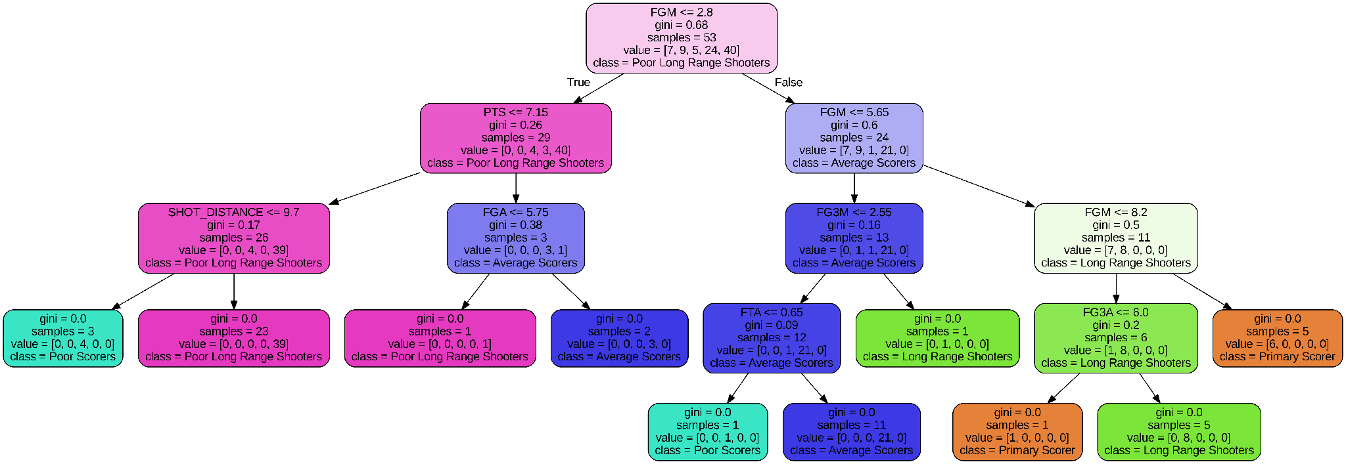
Extension Methods
Notes:
I used 2 predictive methods. Random Forest and SVM.
I was originally going to also train a Neural Network, but I realized while working on it that this was a poor task for NN’s.
Random forest is an ensemble technique that makes lots of decision trees like the one pictured above, and does aggregating to make an overall better decision model than any individual tree. Here is a decision tree from my random forest model for the offensive clustering and we can see how it uses aligns with the intuition developed for these clusters at every step in classifying them. This visualibility is exactly why I chose to use Random Forest in this project.
SVM is a technique that geometrically separates points in order to classify them, for higher than 3 dimensional data like the data used in this project, this is often not visualizable. I included it as a backup to the random forest, to see if its results proved as effective. Which they did.

Slide 4
Offensive Archetypes
01
Primary Scorers on all fronts
02
Long Range Shooters
03
Poor Scorers
04
Average Scorers
05
Poor Long range shooters
Notes:
These are brief titles of the 5 offensive archetypes we ended up with.
Importantly we can see both scoring style of players as well as their effectiveness on the court. In particular we expect players in archetypes 1 and 2 to be carrying their teams offensively.

Slide 5
Defensive Archetypes
01
No notable defensive characteristics
02
On ball defenders
03
Primary rebounders and shot blockers
04
No notable defensive characteristics
05
Secondary rebounders, stealers

Slide 6
Playmaking/Misc Archetypes
01
Mid size guards primary playmakers
02
Mid height, low weight, secondary playmaker
03
Taller heavier centers/forwards
04
Shortest smallest guards
05
Mid height, heavier forwards
06
Tallest heaviest, playmaking centers/forwards
Notes:
BAILEY
Usage percentage refers to how many possessions a player will use on the court. This can help measure a player's playmaking abilities as well as the ball usage.
Looking at the percentages across the clusters, it makes sense that the primary playmakers in cluster 1, the playmaking centers and forwards in cluster 6, as well as the secondary playmakers in cluster 2 have the highest usage percentage. This not only helps us look at the clusters performances, but helps solidify the characteristics of the clusters.

Slide 7
Nikola Jokic
Random Forest
SVM
Offensive
Average Scorer Early Seasons
Primary Scorer Recent Seasons
Defensive
Rebounder and Shot Blocker
Playmaking/Misc
Tall, Heavy, non Playmaker
Offensive
Average Scorer Early Seasons
Primary Scorer Recent Seasons
Average Scorer 2022
Defensive
Rebounder and Shot Blocker
Playmaking/Misc
Tall, Heavy, main Playmaker
Notes:
Here I have the predicted clusters of Nikola Jokic one of the key members of the Denver Nuggets. We can see that both models were very effective at describing him as a player except in 2 key spots.
The RF model described him as only an average scorer in 2022 and the SVM model incorrectly did not describe him as a significant playmaker on the nuggets.

Slide 8
Jamal Murray
Random Forest
SVM
Offensive
Effective Long Range Shooter
Defensive
Not a Notable Defender
Playmaking/Misc
Mid Sized, Strong Playmaker
Offensive
Effective Long Range Shooter
Defensive
Not a Notable Defender
Playmaking/Misc
Tall, Heavy Non Playmaker
Notes:
Here we have the same analysis for Jamal Murray, another of the most important players on the nuggets. Again the predictive techniques were effective in most cases with only a discrepancy in the Playmaking/Misc category where it described Jammal Murray as a taller heavier non playmaking player.

Slide 9
Further Work
Whole Team Comparison using Distributions
Extending to the Entire NBA/More Teams
Investigation of Model Discrepancies

